Slide 1



Scanning…
What Fell Under the Radar? Accountability and the NYPD
Shantell Richardson
Christian Rios-Chambi
Jing Wu
Notes:
We approached this info as data journalists on assignment, with the goal of highlighting the need for the Civilian Complaint Review Board (CCRB) and to bring attention to the potential impact of their work.

Slide 2
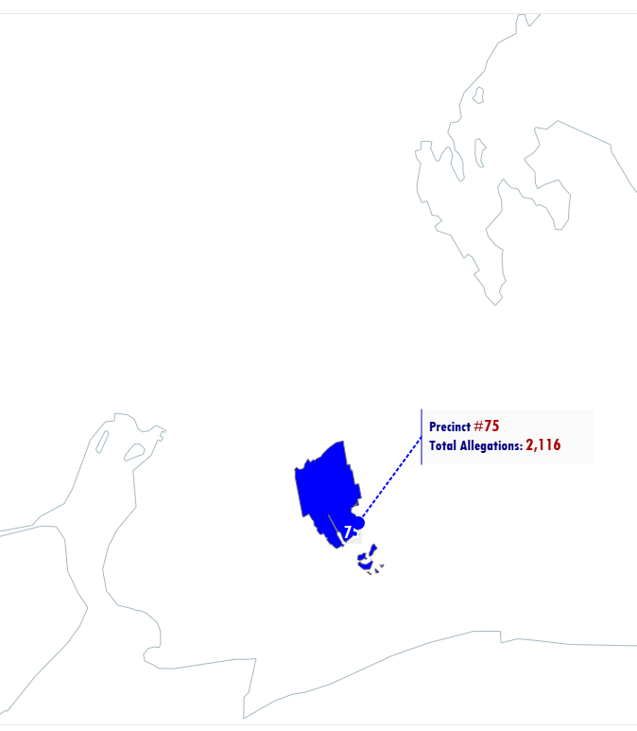
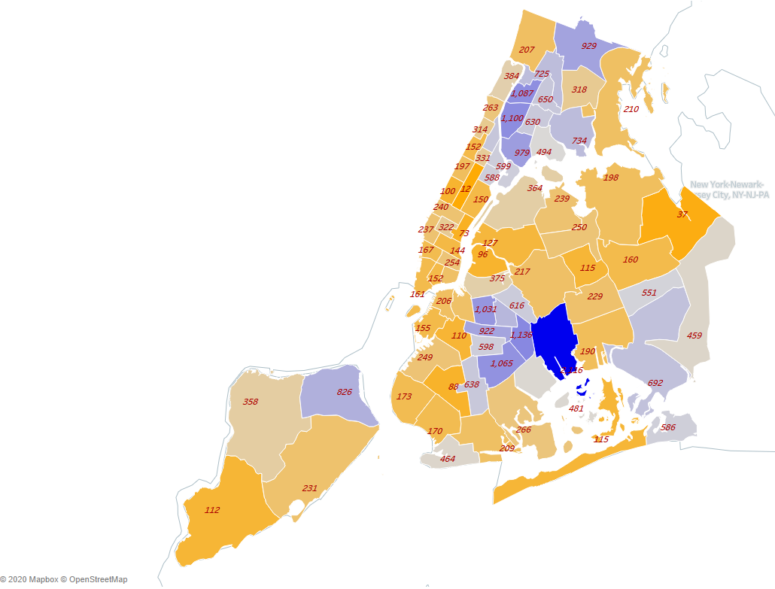
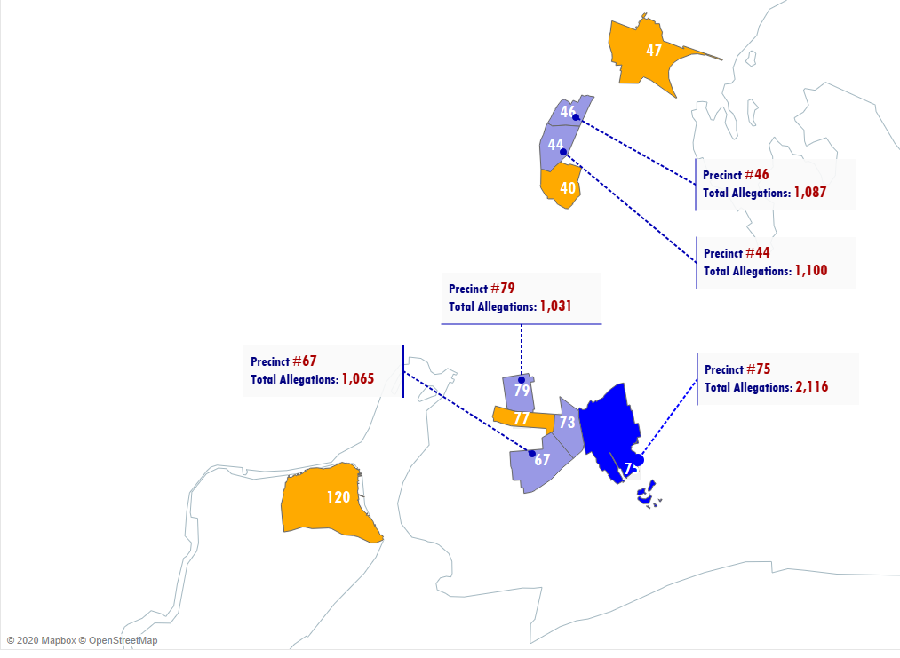
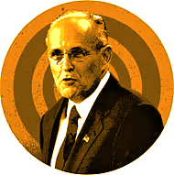



The Giuliani Era
Precinct #75 accounts for 4.5% of all allegations from 1994 to 2003
Total Allegations by Precinct
The Bloomberg Era
Precinct #75 accounts for 7.3% of all allegations from 2004 - 2013
The DeBlasio Era
Precinct #75 accounts for 5.9% of all allegations from 2014 to 2020
Notes:
The map shows the frequency of allegations occurring per precinct. The top 10 and the top (#75) offending precincts are also visualized.
From more in depth calculations of these numbers, we were also able to deduce the total allegations per precinct, under each NYC mayor from 1994 to 2020. We found that precinct 75 consistently yielded the most complaints. With such a long history we wanted to take a closer look into the severity of these allegations and what actions were being taken to reduce them.

Slide 3
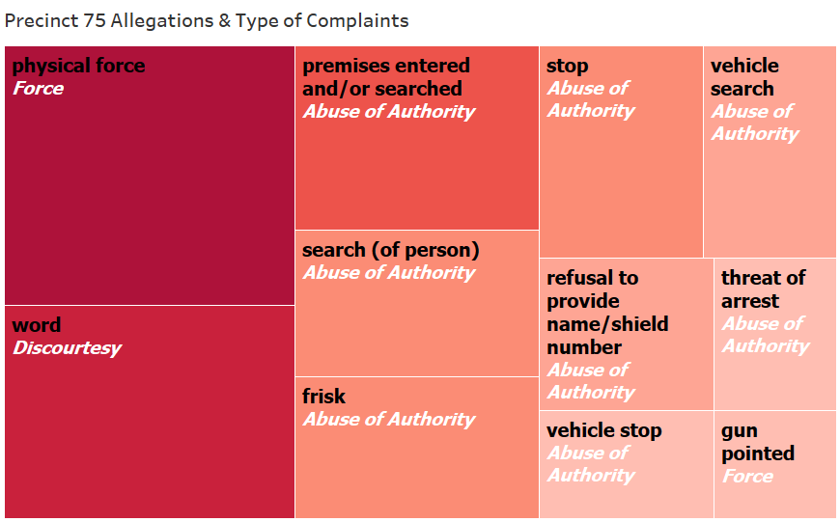




Top Allegations Against Precinct 75
Allegation (black) =
Specific type of complaints
Fado Type (white) =
Umbrella category of complaints
Notes:
Found top allegations were physical force, word, searches(either person or vehicle), there was even consistently allegations that precinct 75 pointed their weapons. Physical force was the top allegation against Precinct 75.
The most common umbrella type of allegation (shown in white) was abuse of authority.
Since 75 had highest numbers of allegations against them spanning from 1994-2020, we wondered what was going on? Were officers being held accountable?

Slide 4
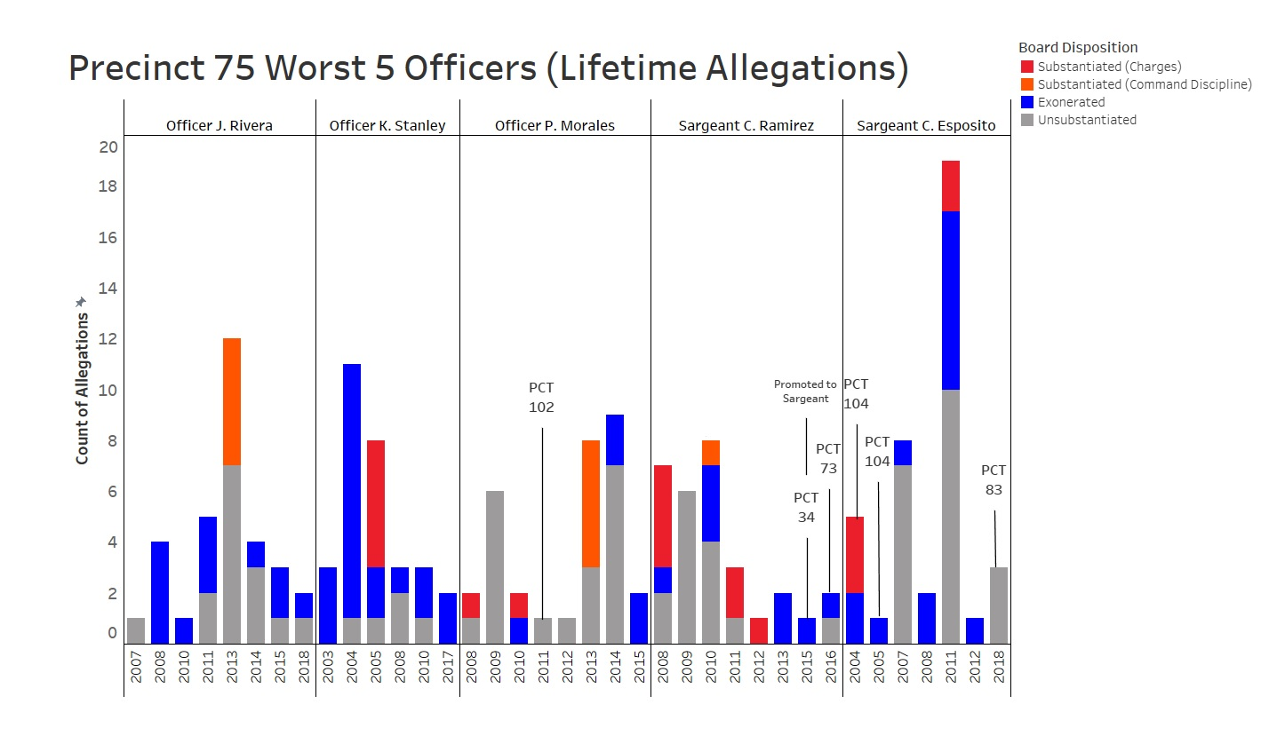

The PCT # annotation shows whenever a officer received an allegation outside of Precinct 75
Notes:
Continuing our focus on precinct 75, we wanted to know how the worst performing officers were being held accountable. We decided to look into the top 5 officers with the most allegations during their time in 75 and also make sure to show allegations from other precincts that they were a part of also (why we have lifetime).
Each officer on this chart has received at least 5 substantiated allegations throughout their career.
3 out the 5 officers shown here has had multiple disciplinary actions after having received one prior. For example, Sgt ramirez has had 8 substantiated allegations against him (7 resulting in charges) between (2008 -2012) before he was rewarded with a promotion to Sgt in 2015
Charges and command discipline don’t seem to be an effective deterrent
Overall the behavior at precinct 75 is so long standing it is indicative of patterns across the NYPD and we would like to do further analysis on other similar performing precincts.

